Slide 1
Deploying Java Apps with Docker
Fernando Segura
Director of Infrastructure @ Osigu
@fernandosure

Slide 2

Agenda
What is docker
Integrating Java with docker
What is CI/CD
DEMO - Deploying java apps with Docker Cloud
@fernandosure

Slide 3
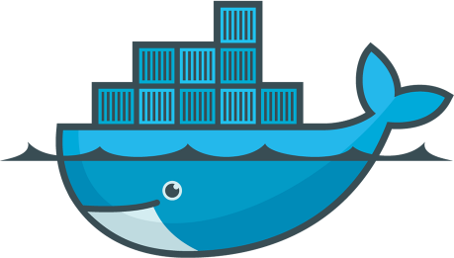
So, what is Docker?
@fernandosure
Notes:
Is an open standard for using containers enabling them to run on all major Linux distributions and on Microsoft Windows -- and on top of any infrastructure.

Slide 4
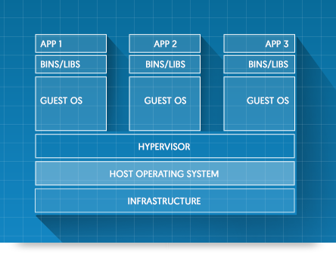
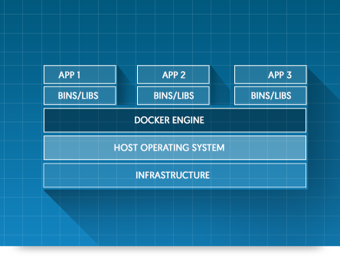
What is a container?
@fernandosure
Notes:
VIRTUAL MACHINES
Virtual machines include the application, the necessary binaries and libraries, and an entire guest operating system -- all of which can amount to tens of GBs
CONTAINERS
Containers include the application and all of its dependencies --but share the kernel with other containers, running as isolated processes in user space on the host operating system. Docker containers are not tied to any specific infrastructure: they run on any computer, on any infrastructure, and in any cloud

Slide 5
Benefits of containers
Isolation
Lightweight
Portability
Fast application startup (from minutes to seconds)
@fernandosure

Slide 6
Docker terminology
Docker engine
Builds, ships and runs the containers, either on the host locally or in the cloud
Docker image
Read-only template for creating containers (snapshot)
Docker container
Runtime representation of the image
Docker registry (https://hub.docker.com)
Place for storing and sharing docker images
@fernandosure

Slide 7
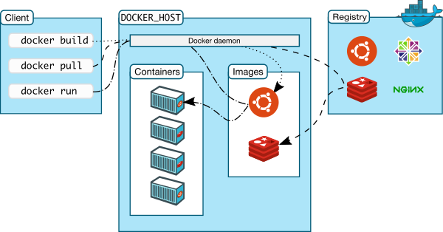
Docker flow
@fernandosure

Slide 8
Integrating Java with Docker
Dockerfile
FROM java:8
ADD java-docker-integration.jar app.jar
ENTRYPOINT ["java", "-jar","/app.jar"]
@fernandosure

Slide 9
Build, Ship, Run
docker build –t java-docker-integration .
docker push fernandosure/java-docker-integration
docker pull fernandosure/java-docker-integration
docker run –p 8080:8080 java-docker-integration
Note: Installing docker
sudo curl -fsSL https://get.docker.com/ | sh
@fernandosure

Slide 10
Spring boot, Gradle & Docker
DEMO
@fernandosure

Slide 11
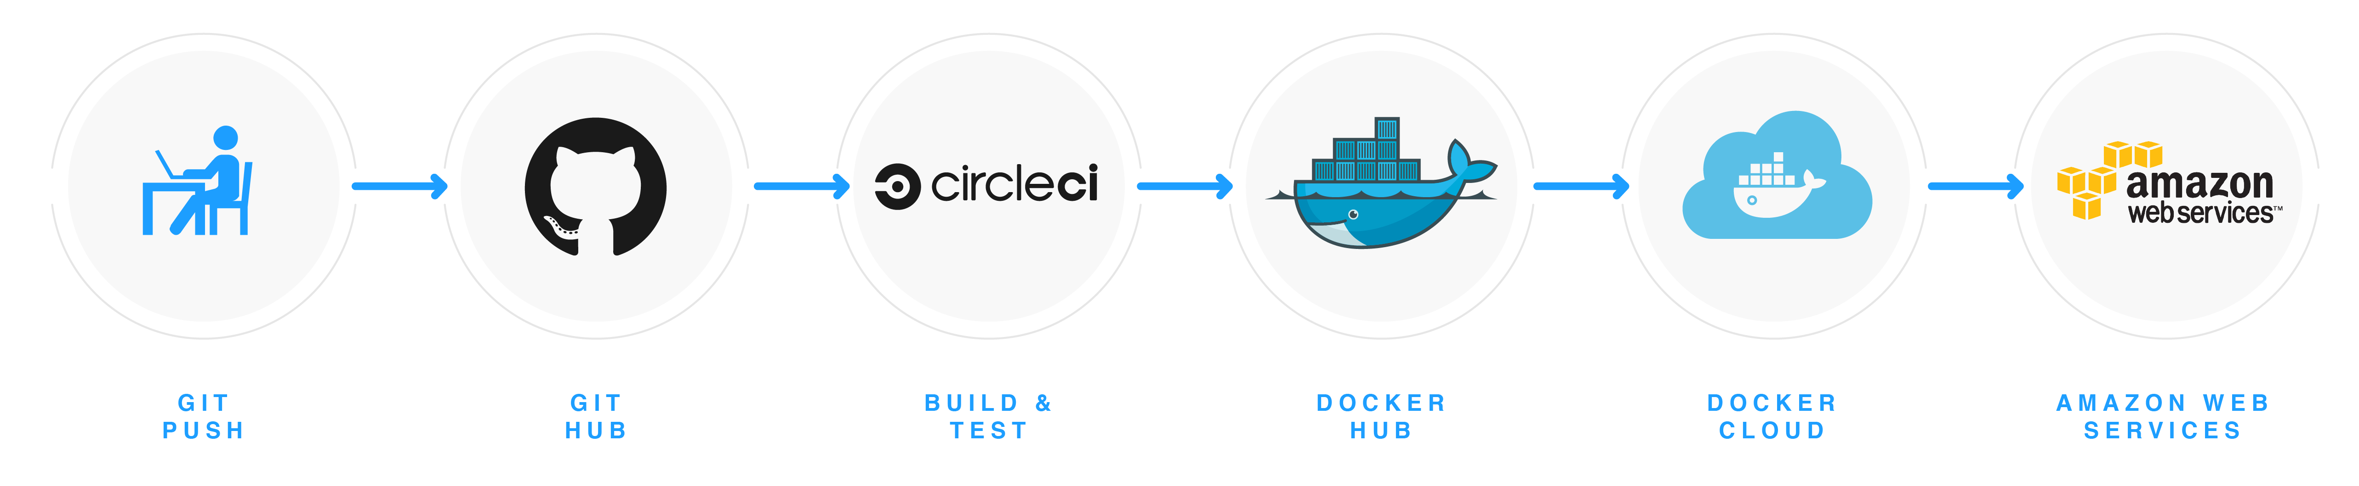
What is CI/CD
CI = Continuous Integration
CD = Continuous delivery / deployment
repeatable & reliable process
@fernandosure

Slide 12
Deploying java apps with Docker Cloud
DEMO
@fernandosure

Slide 13
References
Github https://github.com/fernandosure/java-docker-integration
Docker http://docker.com/
Docker Hub http://hub.docker.com
Docker Cloud http://cloud.docker.com
Docker gradle plugin
https://github.com/spotify/docker-maven-plugin
https://spring.io/guides/gs/spring-boot-docker/
CircleCI http://circleci.com
@fernandosure

Slide 14

@fernandosure

